Slide 1


Developing ZIP Support for the XRootD Client
CERN summer project
June – August 2020
Sonia M Marshall
Supervisor:
Michal Simon

Slide 2


Who am I?
4th Year Informatics Student
University of Edinburgh
Visited CERN on school Physics trip (2016)
I like to jump on things (see photo)
CERN Summer Student... sort of (pandemic times!)

Slide 3

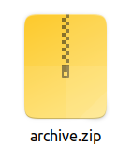
Project Overview
8 weeks, June – August 2020
XRootD Client
Existing functionality:
extract file from ZIP archive
Functionality to add:
append file(s) to existing ZIP archive
create new ZIP archive
C++ API (used by LHC experiment frameworks and software defined storage solutions e.g. EOS)

Slide 4

XRootD and High Energy Physics
What is XRootD?
Software framework for fast, low latency and scalable data access
Collaboration between CERN, SLAC, Duke University, JINR and UCSD
XRootD client, and XRootD server
What is ROOT?
Data analysis framework, and file format
Why ZIP support?
ROOT file format uses ZIP64 for bundling data
Notes:
- explain that adding this append capability is useful so that you don't need to unzip entire archive and create new archive with all of the files - better to just add it to existing archive, especially given the large amounts of data and that we need it to be fast.

Slide 5
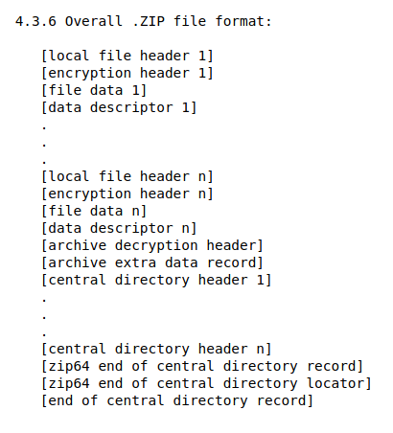
What is a ZIP file?
PKWare's APPNOTE.TXT - .ZIP File Format Specification
(the Holy Book of ZIP Files)
https://pkware.cachefly.net/webdocs/casestudies/APPNOTE.TXT
Bundling files (not necessarily compressed)
Local file headers
Central directory
ZIP64

Slide 6
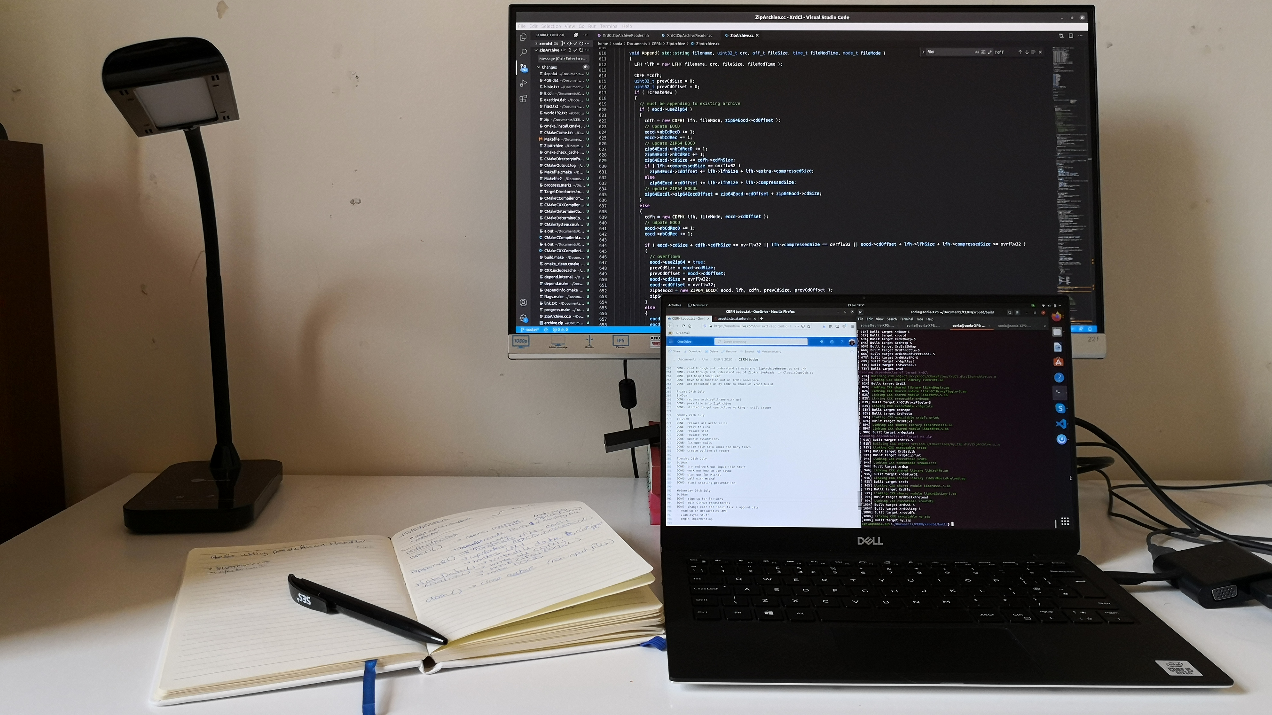
Milestones
Build XRootD project
Create simple local ZIP archive from C++
Create large local ZIP archive using ZIP64 format
Append files to existing local ZIP archive
Append - ZIP64 support
Use XrdCl synchronous API to create/append to remote archives
Investigate using XrdCl asynchronous API

Slide 7
Technical Details

Slide 8
ZipArchive API
ZipArchive::Open(...) // open archive, read existing central directory
ZipArchive::Append(...) // create headers and write local file header to archive
ZipArchive::WriteFileData(...) // write contents of buffer to archive
ZipArchive::Finalize(...) // write central directory to archive
ZipArchive::Close(...) // close archive
Notes:
Efficient – instead of unzipping and rezipping the whole archive, We read the eocd, write the lfh and file data over the existing cd, then add on the new cd and eocd

Slide 9
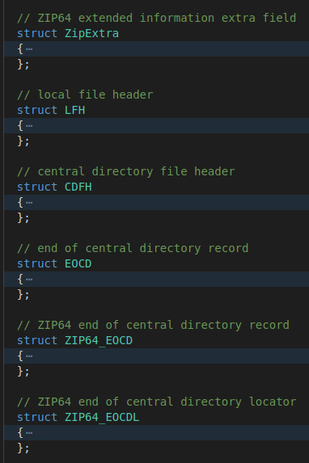
Headers and records
Struct for each type of header/record
Member variable for each field
Write method
Open()
if existing archive, then reads the central directory and EOCD
Append()
Constructs LFH, CDFH, and updates / creates EOCD

Slide 10

ZIP64 Format
Two different things !!
ZIP64 extended information extra field
For when some fields in the LFH and CDFH overflow
Implemented as ZipExtra
ZIP64 end of central directory
For when some fields in the EOCD overflow
Implemented as ZIP64_EOCD and ZIP64_EOCDL
E.g. size / offset stored in 32 bits - but need 64 bit when you have files >4GB
Set the 32 bit field to 0xffffffff, put the large value in the ZIP64 field
4GB

Slide 11
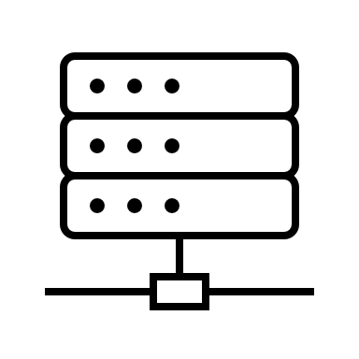
Local vs Remote
Local
Used file descriptors
Used Linux syscalls stat/open/read/write/close
archiveFd = open( archiveFilename.c_str(), O_RDWR, S_IRUSR | S_IWUSR | S_IRGRP | S_IROTH );
Remote
Uses XrdCl::File and XrdCl::Filesystem API
Currently uses the synchronous API
Use URLs - root://host//path/to/archive.zip
st = archive.Open( archiveUrl, OpenFlags::Update, Access::UR | Access::UW | Access::GR | Access::OR );

Slide 12
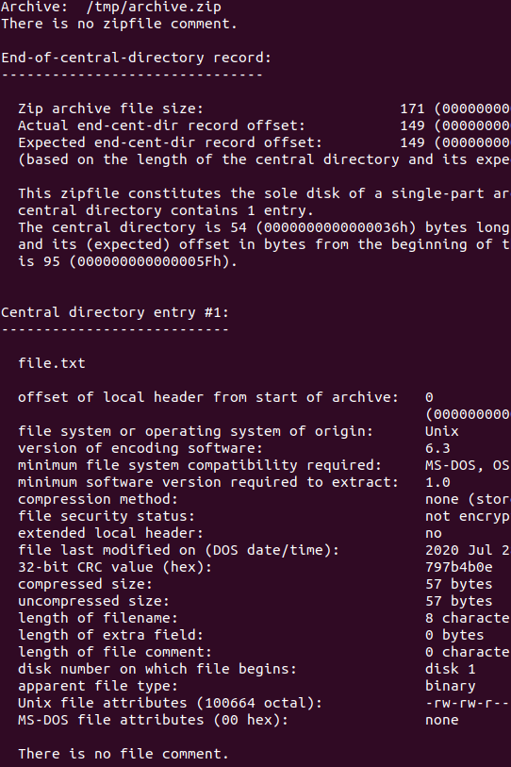
Testing
Use existing tools that recognise the ZIP format:
List the content of the archive using less
Open the archive in vim
Use zipinfo –v to read details stored in central directory
unzip the archive
check unzipped file is the same as input file using diff
If it doesn't work... fix the problems until it does!
Notes:
How to check the file produced meets the specification?

Slide 13

Future work
Asynchronous ZipArchive API
Combine my code into the existing ZipArchiveReader class
Add append functionality into the xrdcp command line tool
Create declarative API for ZipArchive class
Extract file
(already available)
Append file
(to be added)

Slide 14
Thank you, and stay safe!
My code:
https://github.com/xrootd/ZipArchive
Main XRootD repository:
https://github.com/xrootd/xrootd
XRootD website:
https://xrootd.slac.stanford.edu/
My report:
To be uploaded to the CERN
Document Server soon.

